Slide 1
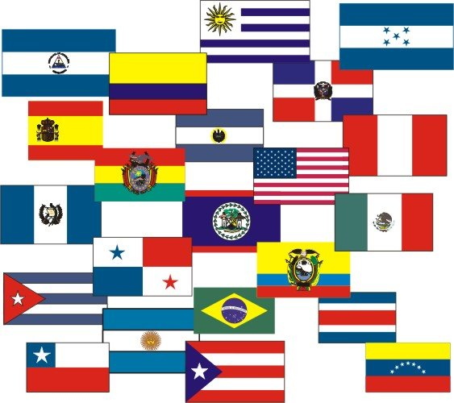
Why learn Spanish?

Slide 2
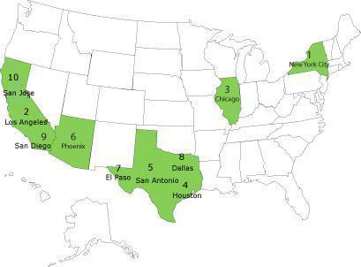
Spanish,
Spanish everywhere.
There will continue to be an enormous increase in Spanish language usage in the United States.

Slide 3
There are over 33 million Spanish speakers in the United States.
Over 40% of the population growth will be among the Hispanic people.

Slide 4
The Hispanic population is estimated to approach 50 million by the year 2015.

Slide 5
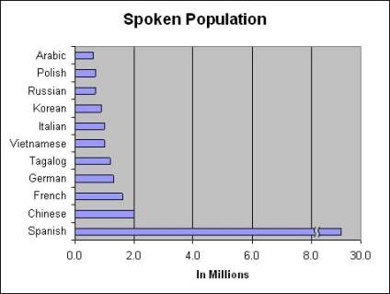
In Europe, Spanish is the second most spoken language, after English.
With more than 300 million speakers, Spanish is the fourth most commonly spoken language in the world.

Slide 6
Only Mandarin, English and Hindi have more speakers than Spanish.
If you count only native speakers, Spanish outranks English.

Slide 7
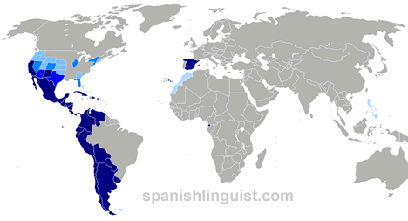
Spanish is an official language on four continents…

Slide 8
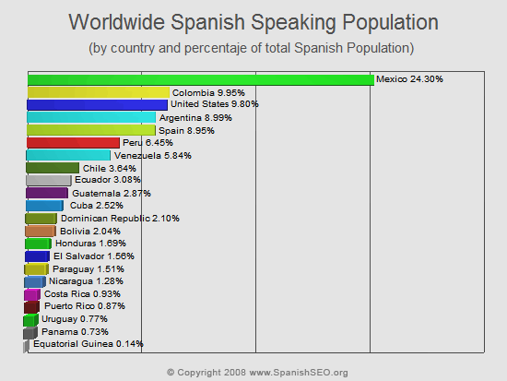
…and is the mother tongue in 21 countries.

Slide 9
The sheer number of Spanish speakers and their rate of growth makes learning Spanish a smart choice.

Slide 10
Learning Spanish is actually preventive medicine!
Speaking two languages reduces your chances of developing dementia, including Alzheimer's Disease.

Slide 11
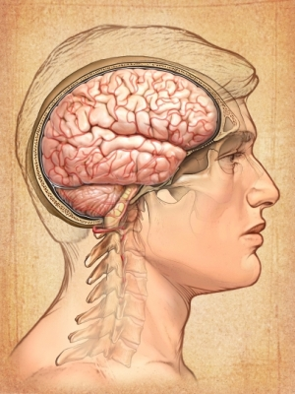
Bilingualism enhances mental abilities in both children and older adults.
Studying languages can improve your memory and slow age-related decline in mental acuity.

Slide 12
Studying another language makes you smarter!
Your critical thinking skills improve as you learn to view things through a different lens.
Learning a second language stimulates creativity!

Slide 13
For many, learning Spanish is rapidly becoming a business necessity.
Learning Spanish will enable you to better communicate with Spanish speaking employees or co-workers.
Think of the impact in business when you can speak the native language of 300 million native speakers of Spanish.

Slide 14
In North America, Hispanic consumers are the fastest-growing market segment.
Having Spanish fluency on your resume will give you an advantage over your competitor.

Slide 15
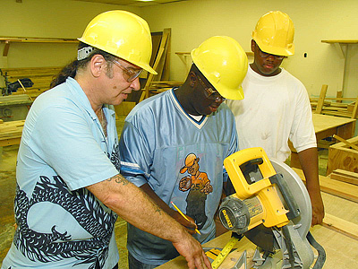
Knowing Spanish is helpful if you work in healthcare or education.
The building trades are employing more and more Spanish speaking workers.

Slide 16
If you are bilingual, you will have more career choices than your monolingual counterpart.

Slide 17
Globalization, with it's free trade agreements, is shrinking the business world.
Those who know more than one language will have an advantage.

Slide 18
Learning Spanish will (truly) expand your universe.
“…the limits of my language are the limits of my universe...“
Austrian philosopher Ludwig Wittgenstein

Slide 19
As the Hispanic population continues to grow at a disproportionate rate, it becomes more likely that you marry into a Spanish speaking family, have Spanish speaking neighbors or encounter Spanish speaking people in your daily rounds.

Slide 20
Spanish speakers are no longer on just the border states and big cities.
Today, nearly all areas have an Hispanic population.
Wouldn't it be nice to say hello and chat with your fellow paisanos (countrymen)?

Slide 21
Knowing Spanish will completely transform your travel experience.
An incredible adventure
awaits the traveler who speaks Spanish.

Slide 22
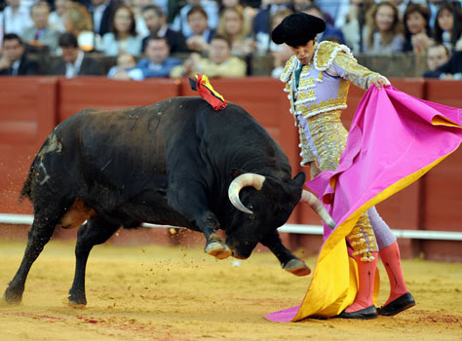
If you only speak English, you will visit only tourist attractions where everyone speaks some English.

Slide 23
When you travel to a Spanish-speaking country, knowing the language will allow you change from observer to participant.

Slide 24
Knowing how to speak Spanish will enable you to help others.
You can help Spanish speakers who don't speak English…
…and English speakers who don't speak Spanish.

Slide 25
There are people in Spanish-speaking nations in serious need.

Slide 26
There are people in Spanish-speaking nations in serious need.

Slide 27
Learning Spanish
will prepare you
for taking
the next
step,

Slide 28
--- actually going there and…
…making a difference!

Slide 29
Learn a language for language's sake.
While Johann Wolfgang von Goethe may have been exaggerating when he said,
"he who knows no foreign language, knows nothing of his own,"
it cannot be denied that by studying Spanish you will without doubt gain a better understanding of English.

Slide 30
Spanish is a "Romance" language. It is derived from Latin, the language of the ancient Roman Empire.

Slide 31
Since many English words are also of Latin origin, when you learn vocabulary in Spanish you will simultaneously be expanding your English vocabulary.

Slide 32
You will also find that your understanding of the deep meaning of these Latin based English words is greatly enhanced.

Slide 33
Spanish grammar is similar to English, as well as different. This will raise your awareness of English grammar.

Slide 34
Spanish is one of the easiest languages to learn.
Because Spanish is nearly phonetically perfect, you can look at almost any word and know how to pronounce it.

Slide 35
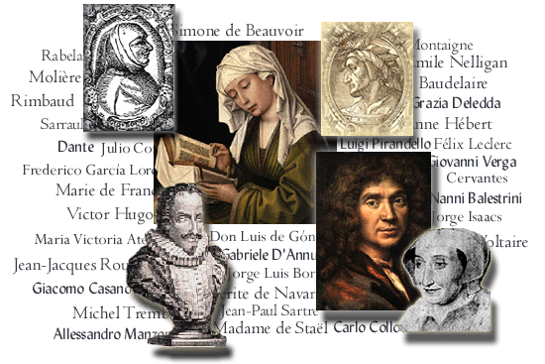
If you learn a third language, such as French, Italian, Portuguese or Romanian, already knowing Spanish will be a huge advantage because these languages, too, are Romance Languages.

Slide 36
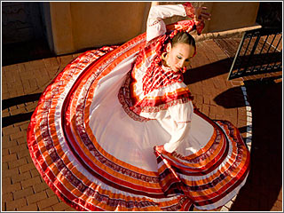
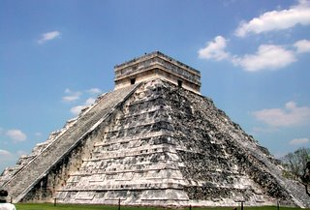
Learning Spanish will allow you to better appreciate Hispanic cultural contributions.
Developing a deeper understanding of Hispanic culture is becoming more and more important.

Slide 37
Reading Latin American or Spanish newspapers and magazines will open a window into the Hispanic mind.

Slide 38
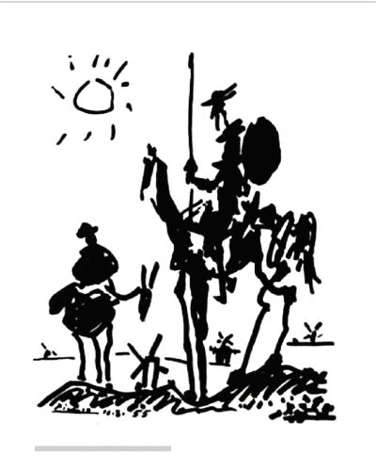
From Miguel de Cervantes …
…to Gabriel Garcia Marquez, Hispanic literary contributions are monumental.

Slide 39
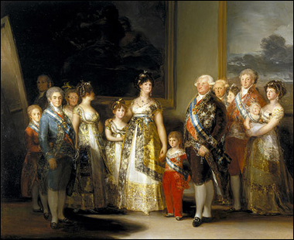
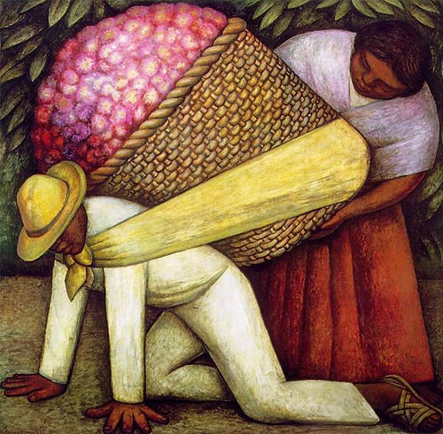
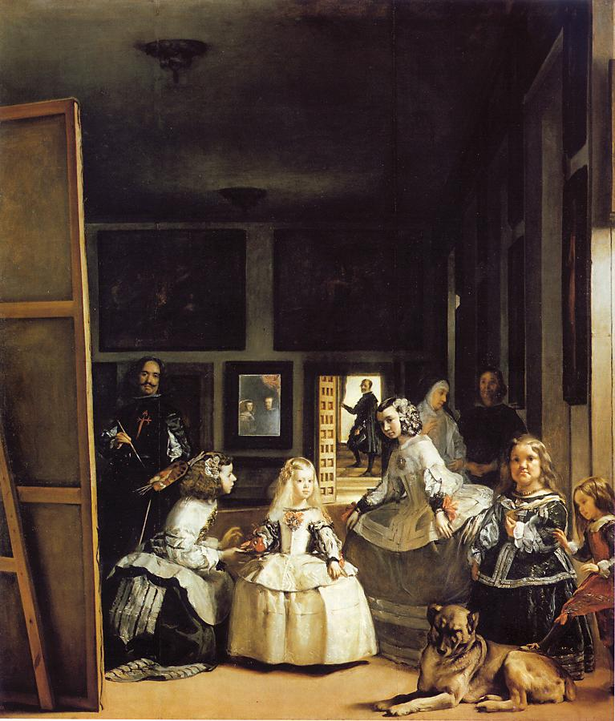
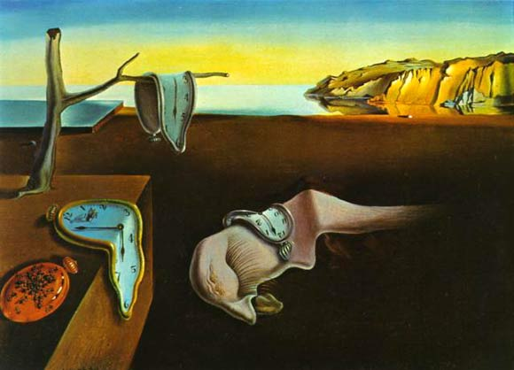
Spanish influence on the fine arts has been substantial.
Goya
Velasquez
Rivera
Picasso
Dali

Slide 40
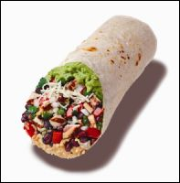
And…gastronomy!

Slide 41
One feels a great amount of pride and accomplishment when you’ve work hard to learn a foreign language.
Learning Spanish can be one of the most rewarding things you will ever do.

Slide 42
Whether your motivations are practical, intellectual or sentimental, learning Spanish is something that will benefit you for the rest of your life!

Slide 43
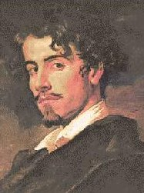
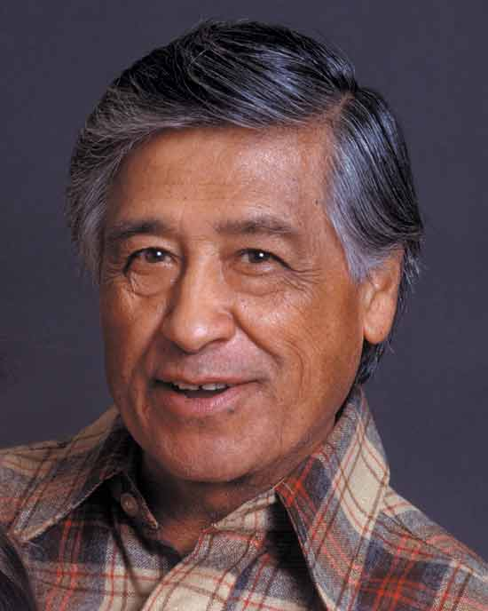
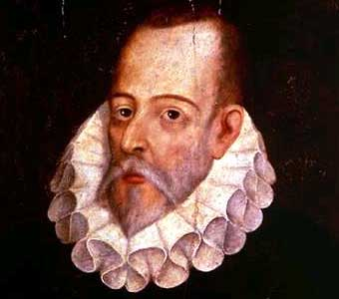
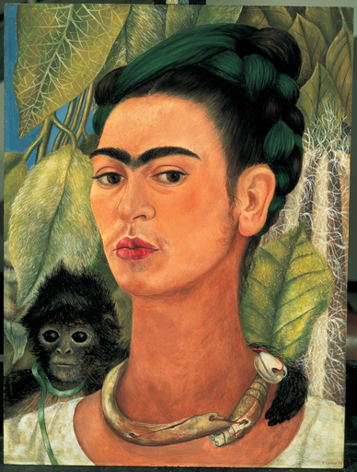
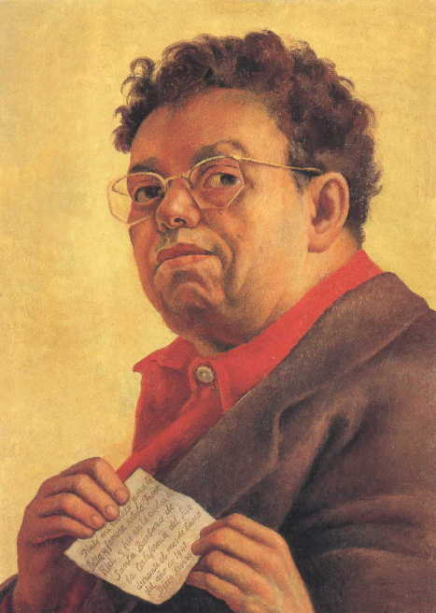
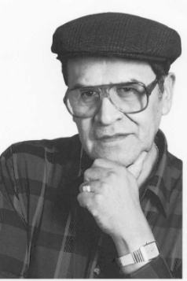
Yo hablo español.

Slide 44
¿Hablas
tú
español?

Slide 45
